Slide 1
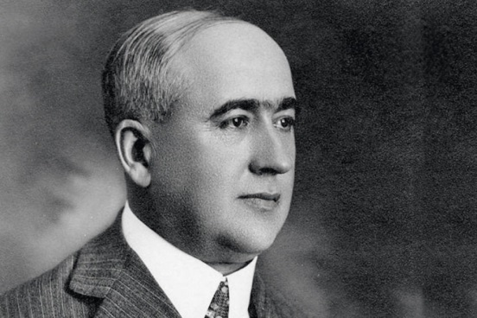
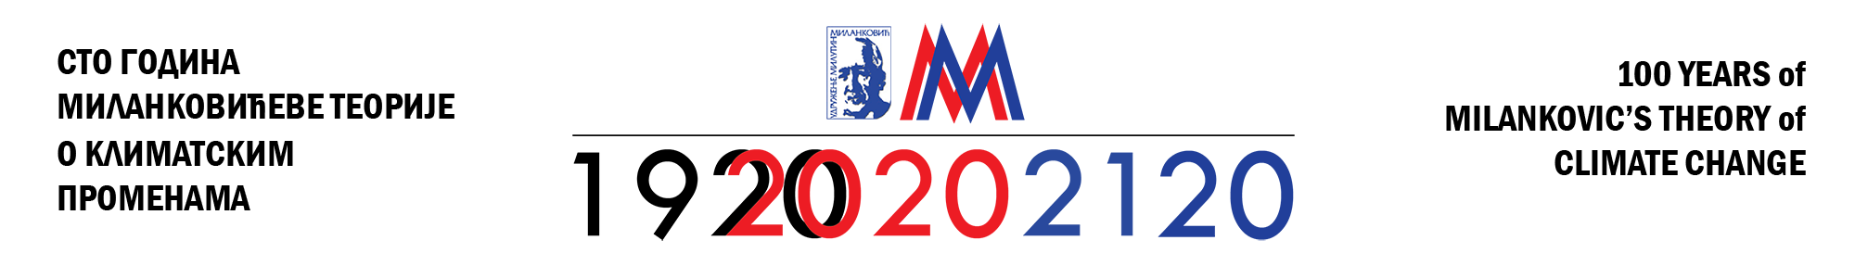

Strategies for urban water management as a part of integrated Blue Green Solutions (BGS) under climate changes uncertainties
Author/s Prof. Čedo Maksimović & Dr. Ana Mijić
Imperial College London, UK

Slide 2
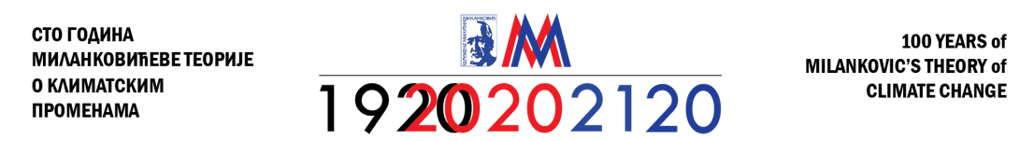

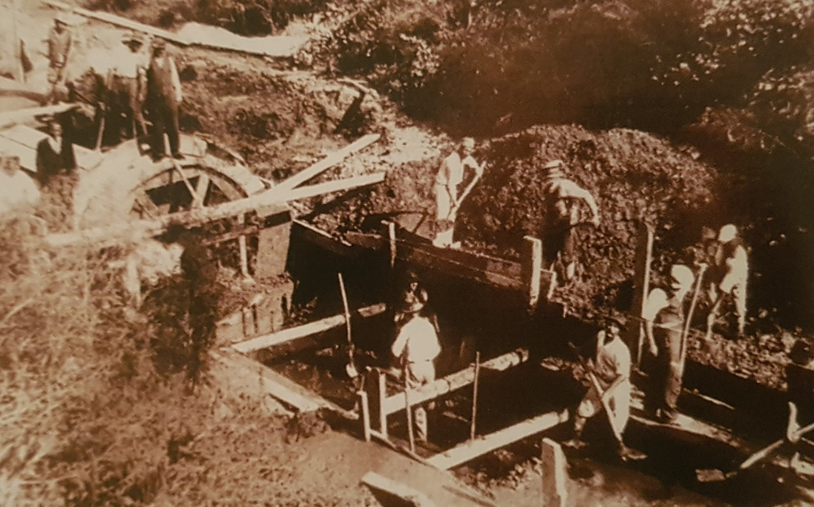
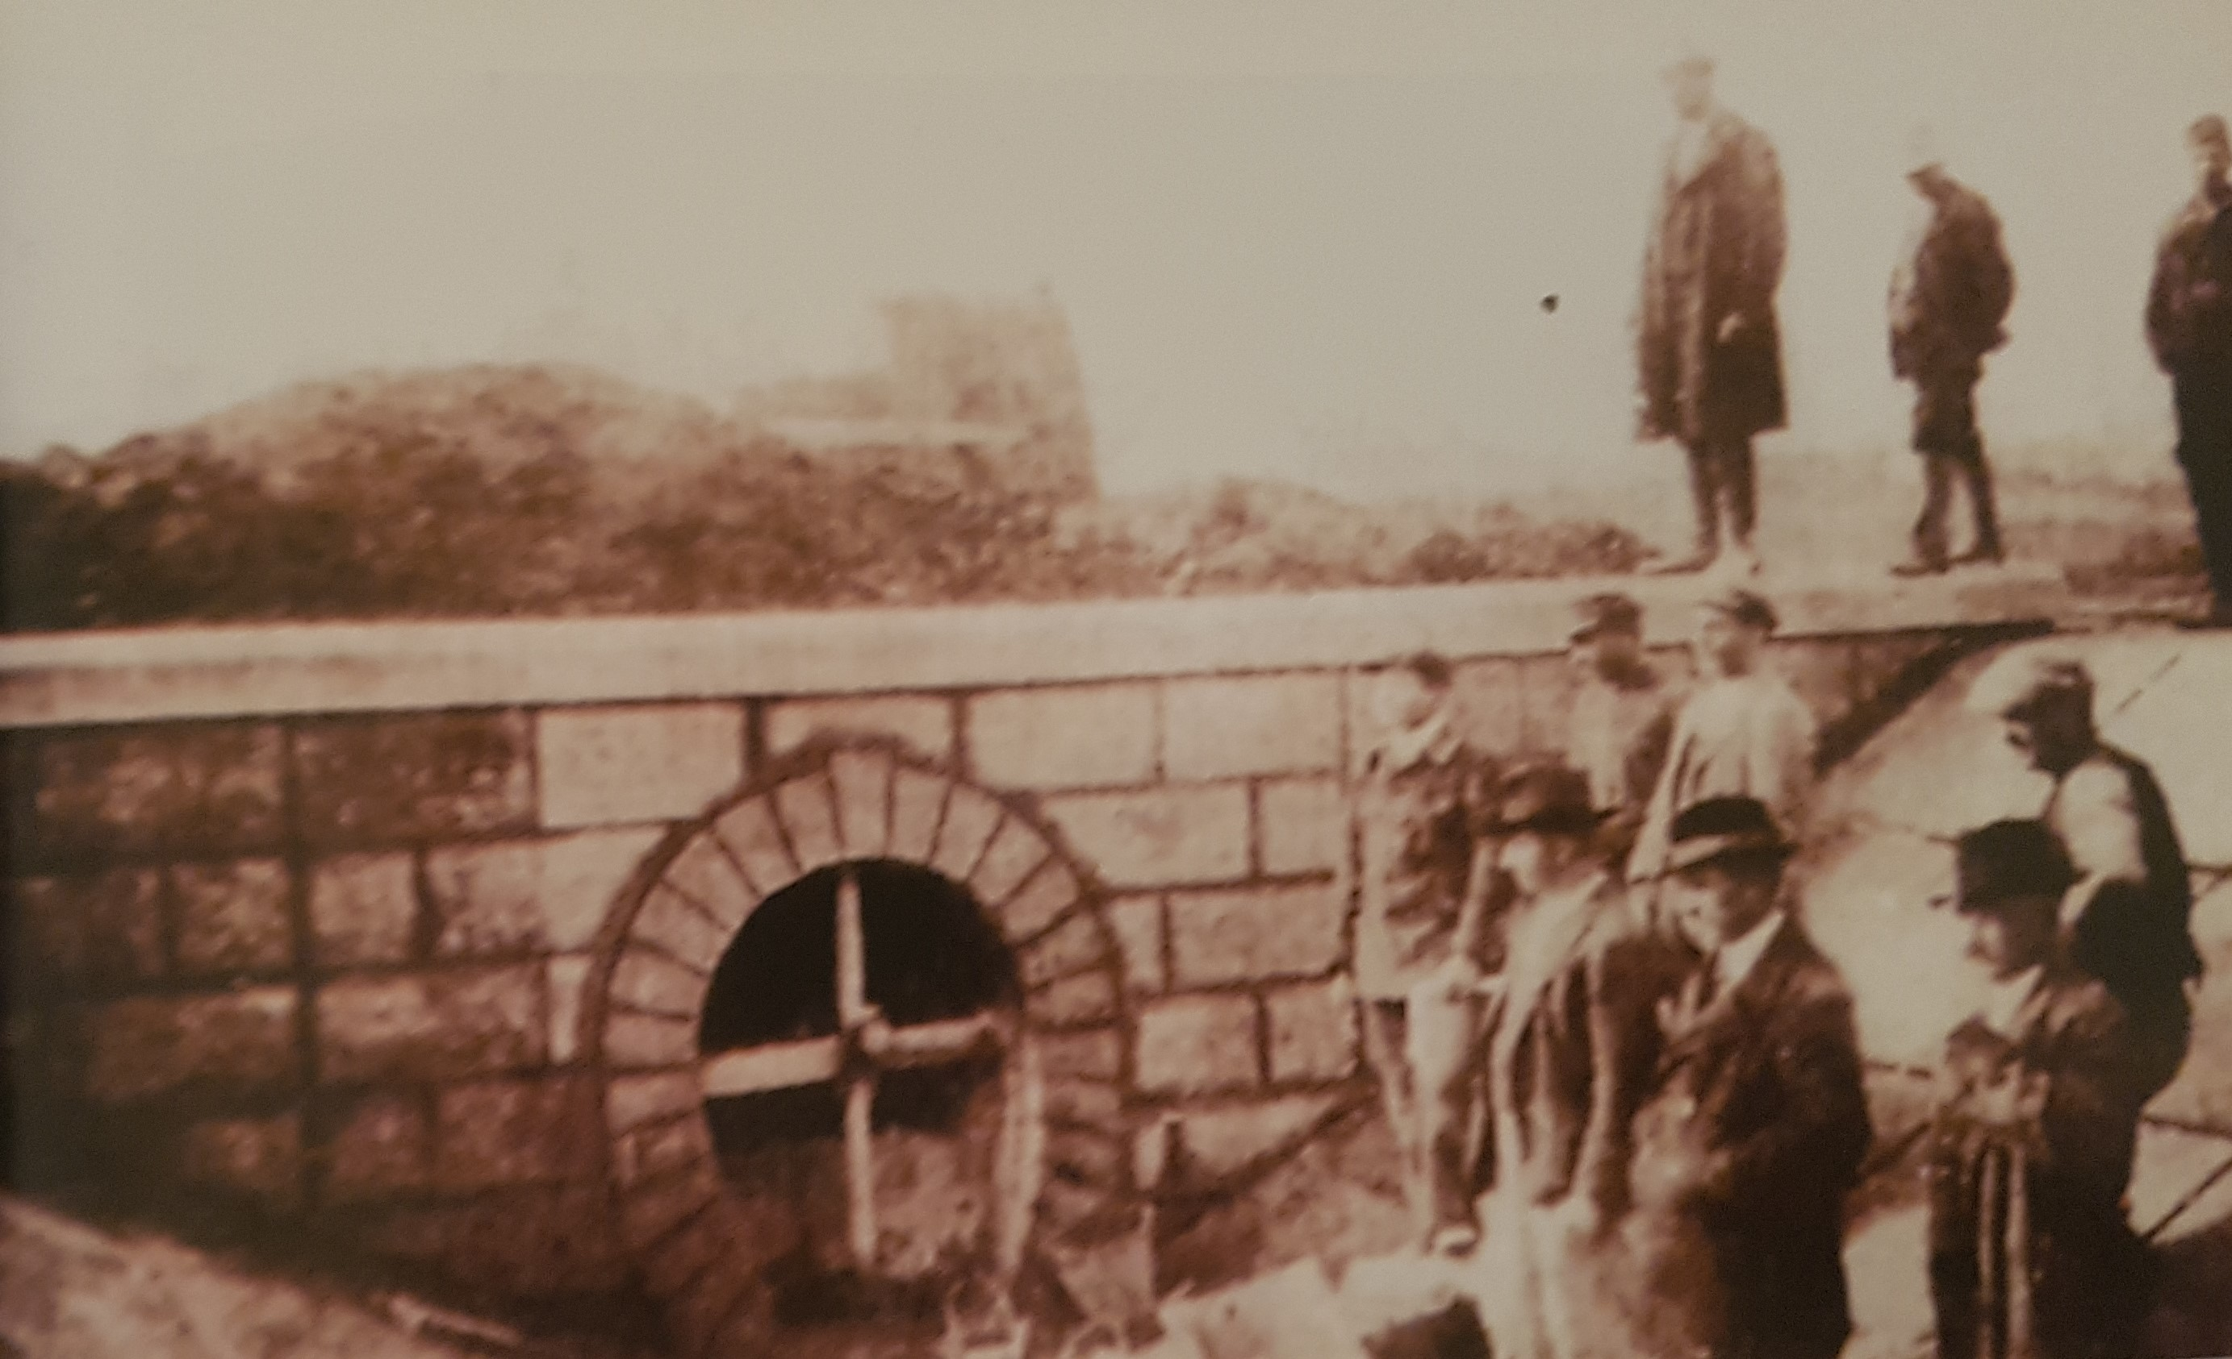
Milanković’s professional work in civil-water engineering in his early career
Birth of modern Sanitary Engineering in England
Milanković’s several important projects in hydropower plants and trunk sewer system in Belgrade

Slide 3
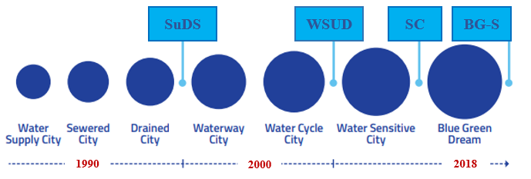
Urban water infrastructure transitions:
from components to an interacting system
A journey towards integrated Blue Green Solutions

Slide 4
Urban water infrastructure transitions:
from components to an interacting system
BGS – Blue Green Solutions encompass Storm Water and WW Systems’ interactions, compatible with the Chinese Sponge City program

Slide 5



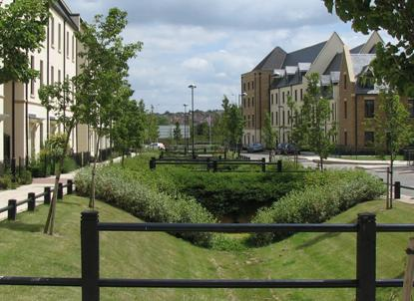
Addressing climate change challenges
Rainfall Estimation / Forecasting
Management (urban planning, emergency)
Flood Modelling / Forecasting

Slide 6
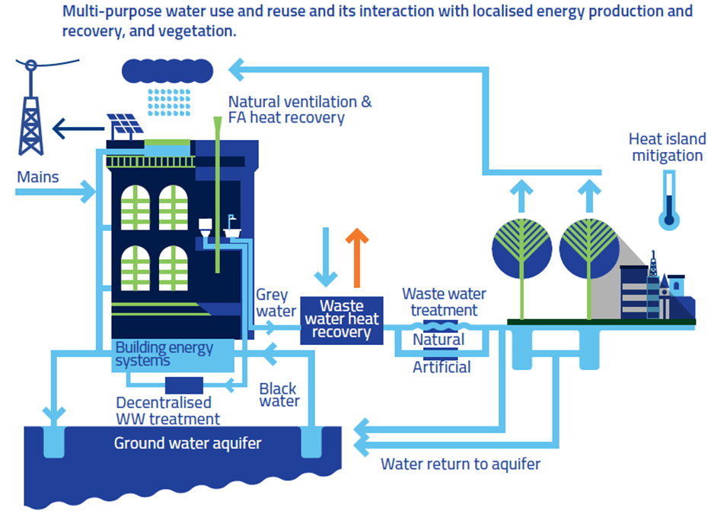

Urban water system interactions
CLIMATE VARIABILITY
WASTE HEAT RECOVERY
BUILDING SHADING
WASHING
COMFORT INCREASE
LESS ENERGY
HVAC SYSTEMS
WATERING
GROUND & RECYCLED WATER
The Benefit: savings on water CAPEX, OPEC and whole development Energy consumption

Slide 7
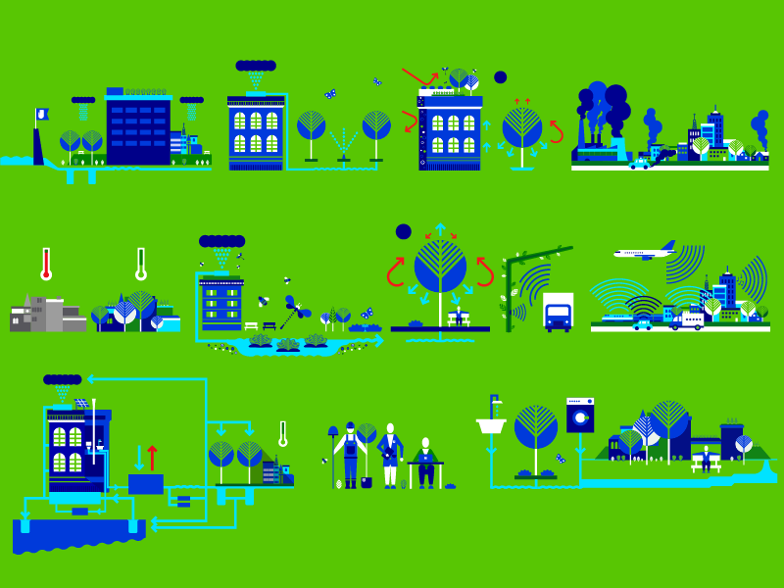

Blue Green Solutions
Blue Green Solutions call for rethinking existing ways of planning, designing, constructing, operating and maintaining urban water systems (blue assets), urban vegetated areas (green assets), buildings, energy, air quality and city behaviour under climate extremes, not as separate systems but in combination.
The innovative advantage of this method is the fact that interactions between components of urban categories including ecosystem services, are quantified, enabling the design team to optimize the whole project, based on parametric results (analysis) and with direct implication on cost and quality.

Slide 8
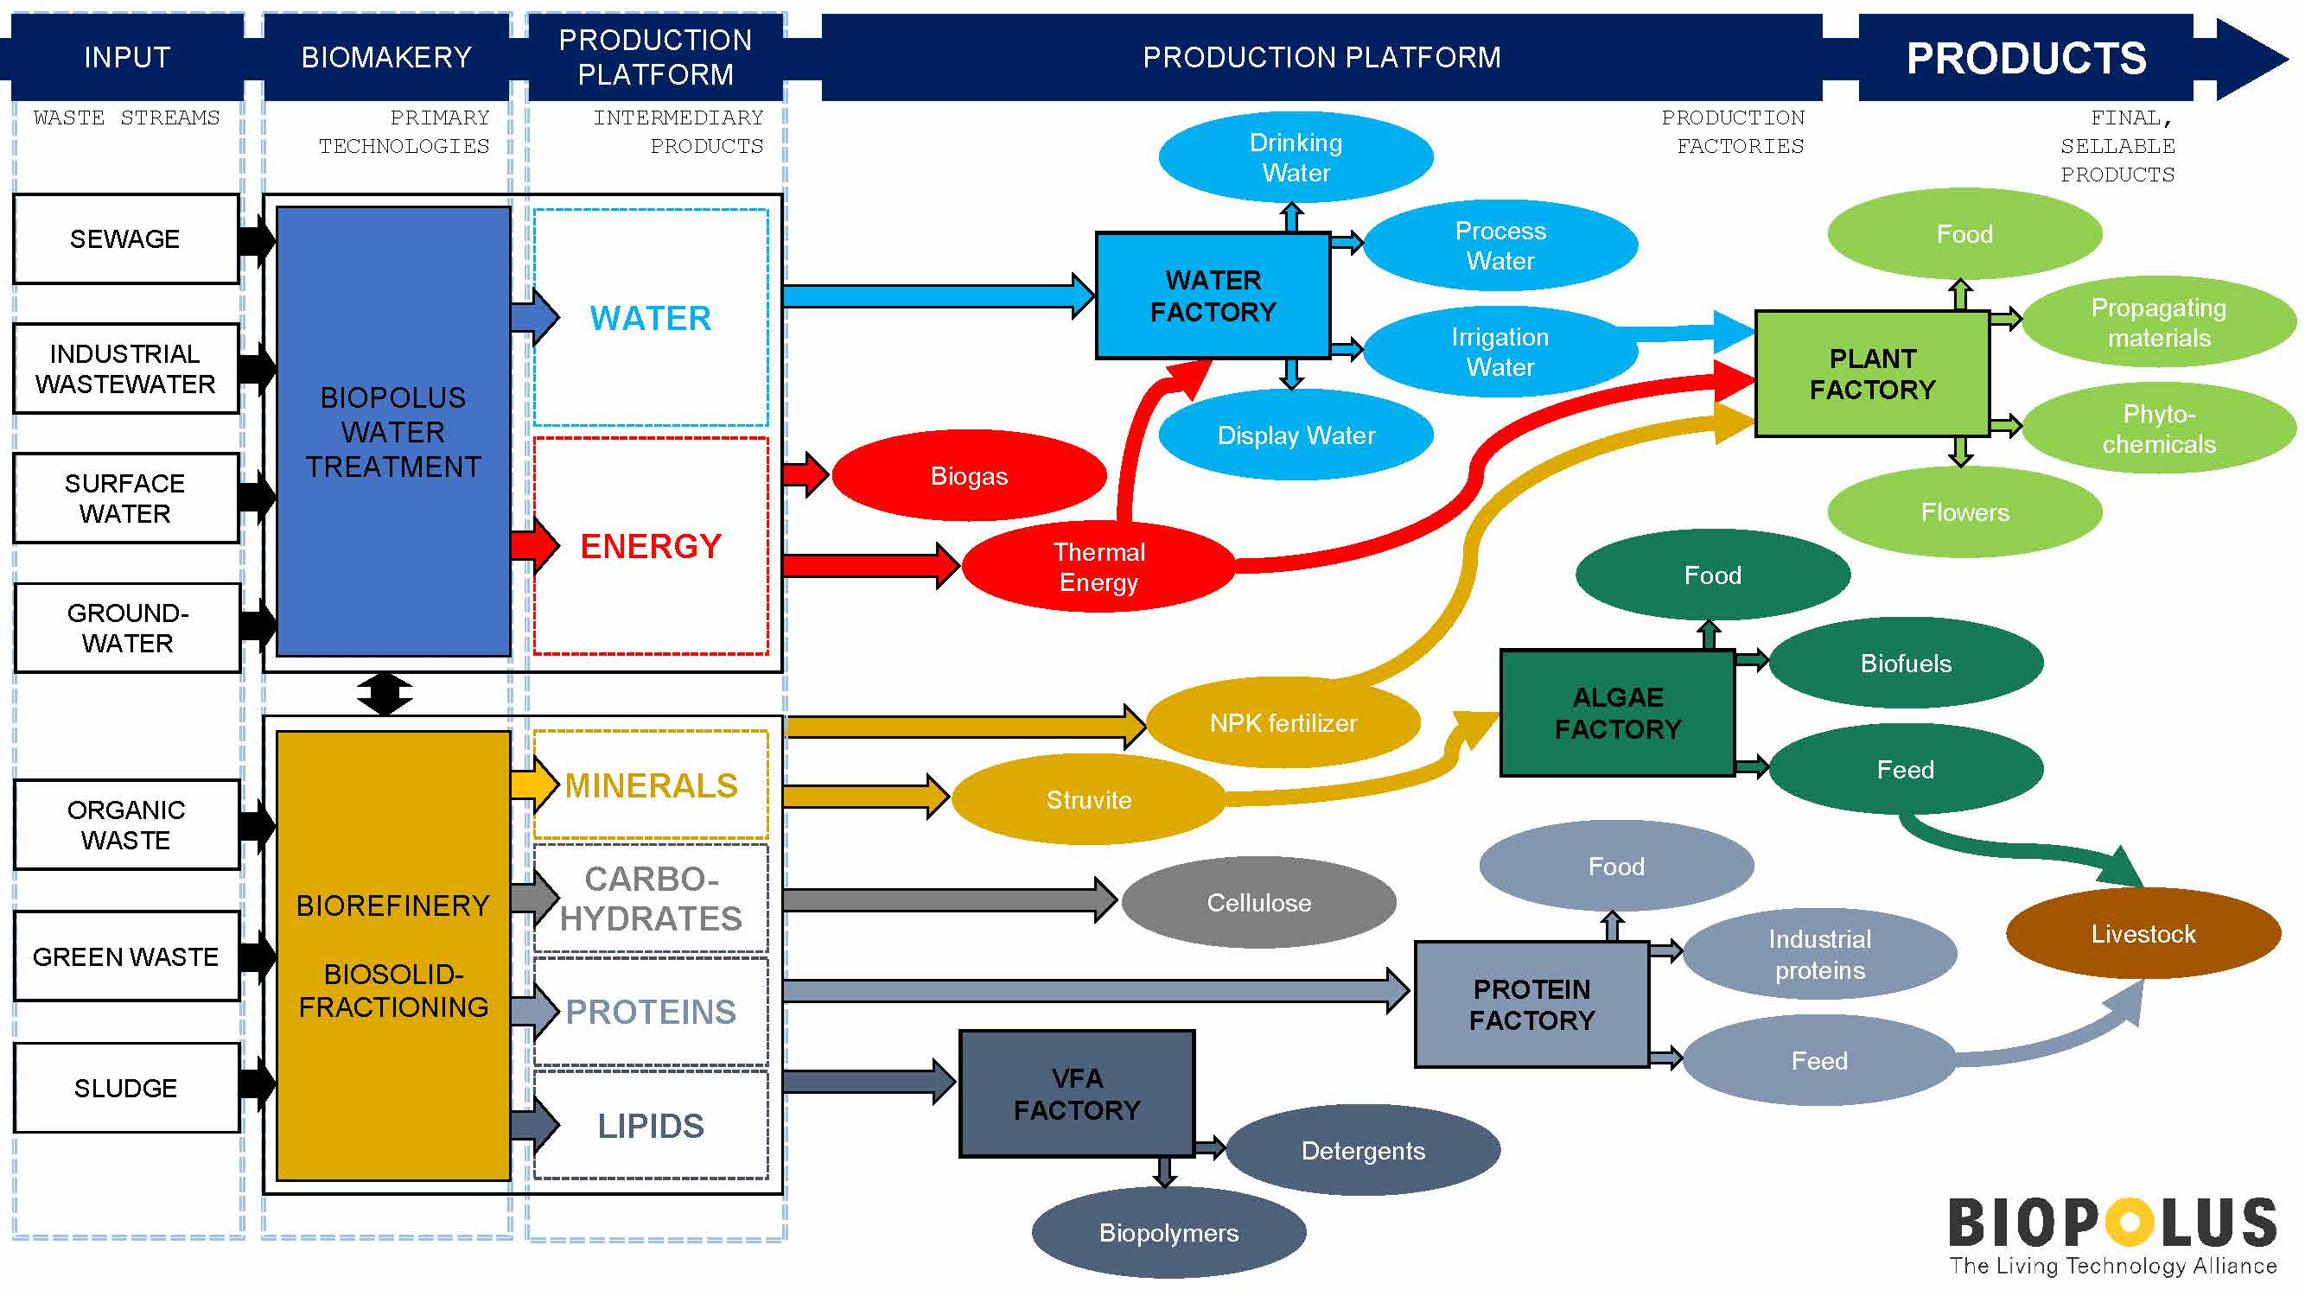
From conventional WWTP to multifunctional resource recycling facility

Slide 9
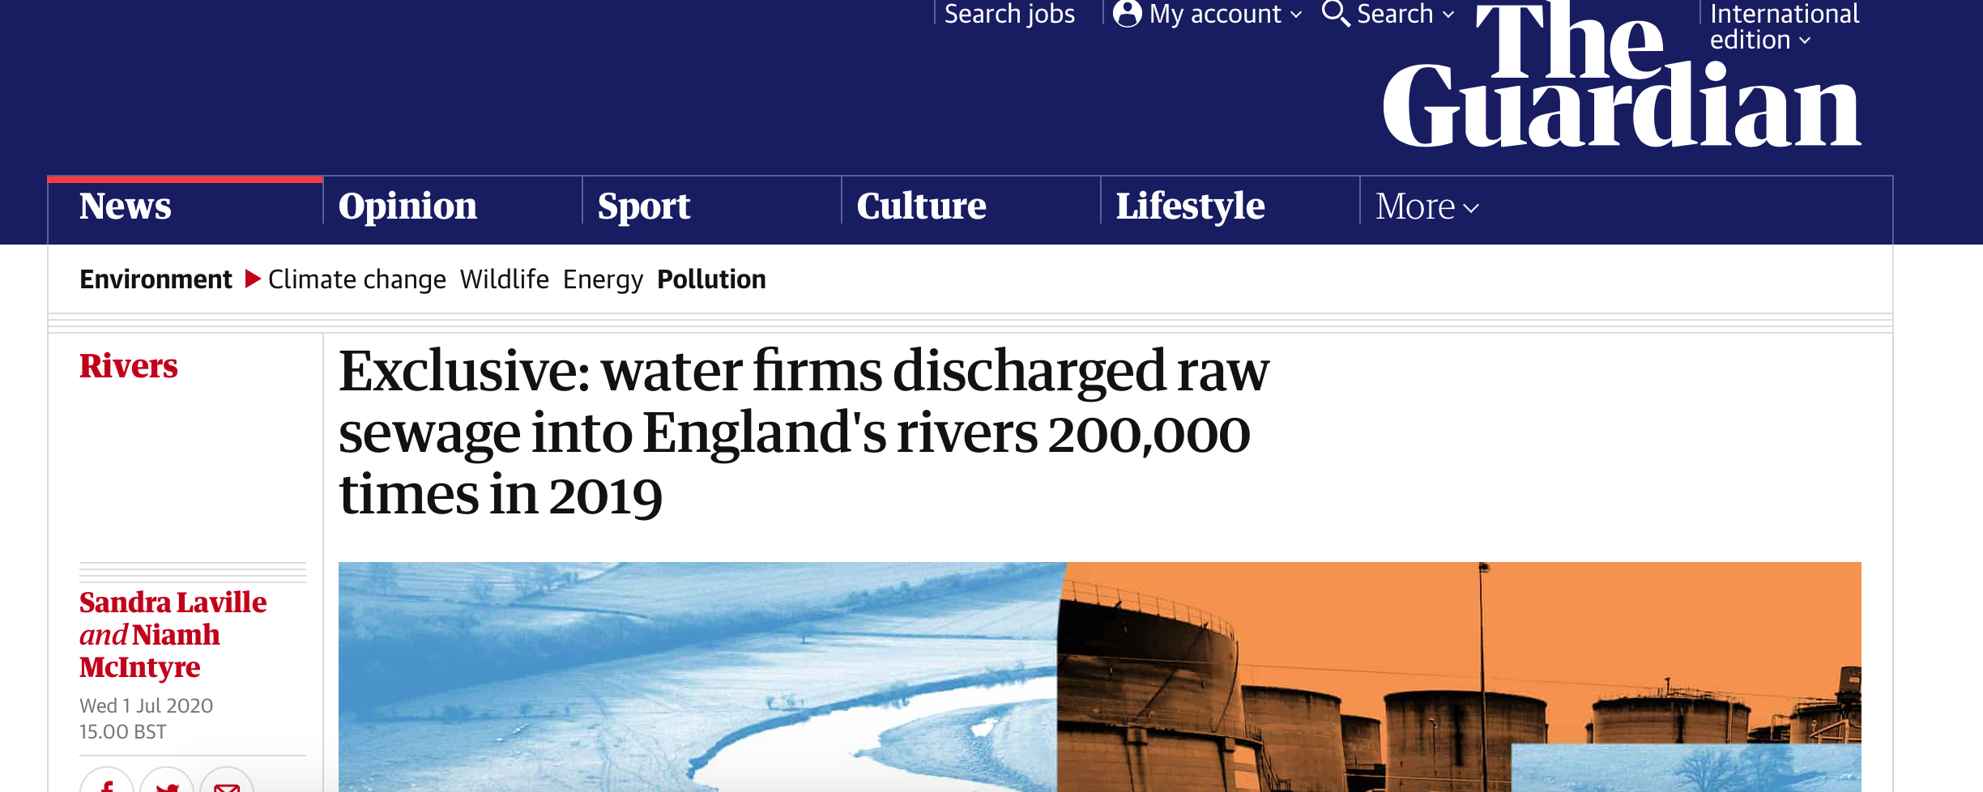

Urban infrastructure and environment
https://www.camelliawater.org

Slide 10
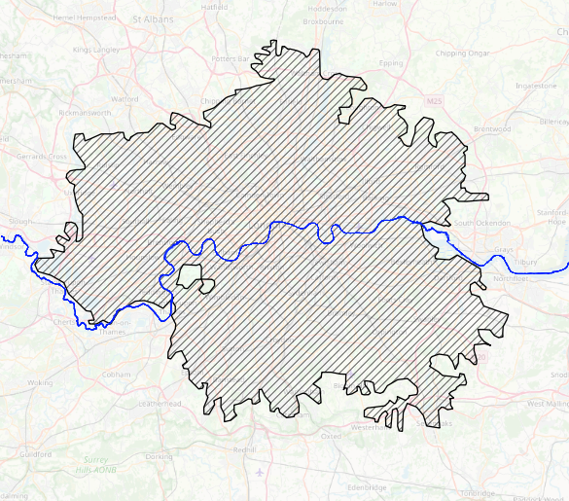
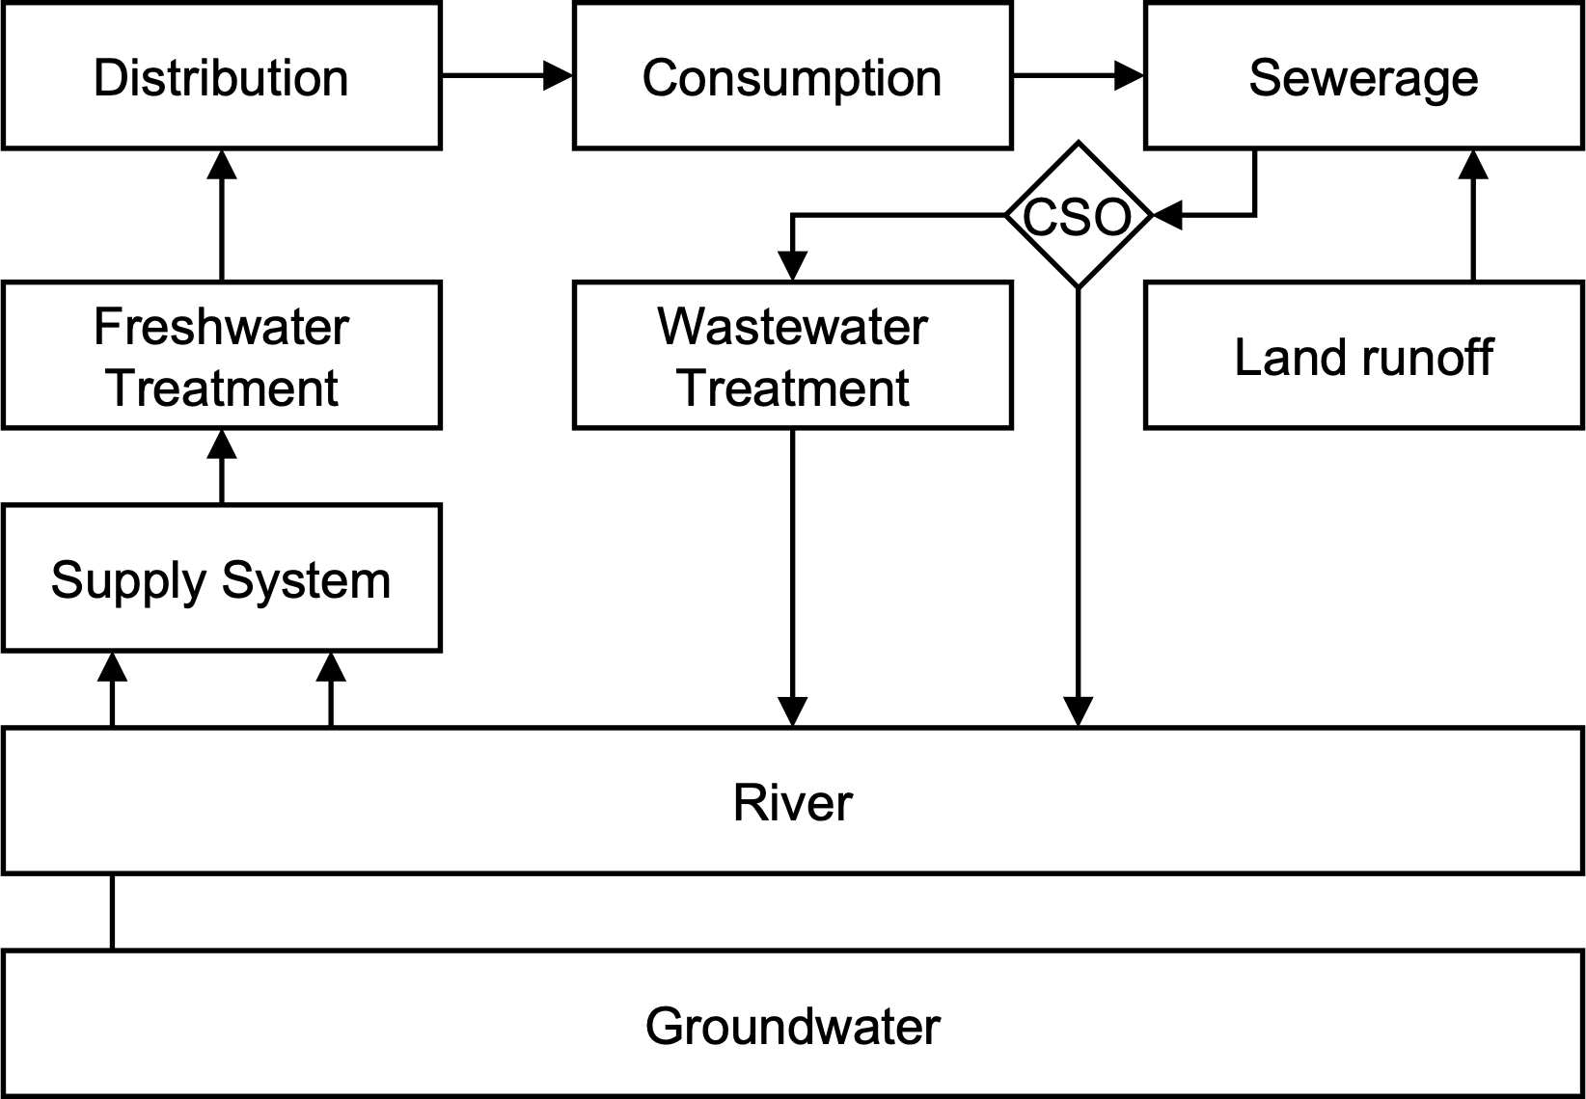
CityWat model
Model
We have simulated the built infrastructure part of London’s urban water management
Data

Slide 11

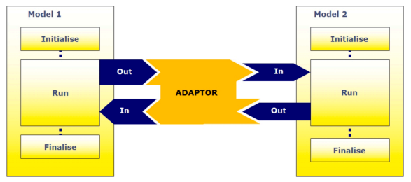
Integrated modelling approach
3. Orchestrate in what order different components are triggered each timestep by drawing on experts of the system in question
1. Start by gathering all the different components (models) you want to represent
2. Use an integration framework to enable components to send and receive information between each other
Component | Spatial type
Junction | Point
Reservoir | Aggregation of reservoirs
Wtw | Point
Distribution | Aggregation of network
Demand | Area
Land | Area
Sewerage | Aggregation of network
Wwtw | Point
Inflow | Point (that drains a catchment)
A Harpham-Hummel adapter from https://doi.org/10.1016/j.envsoft.2019.104549

Slide 12
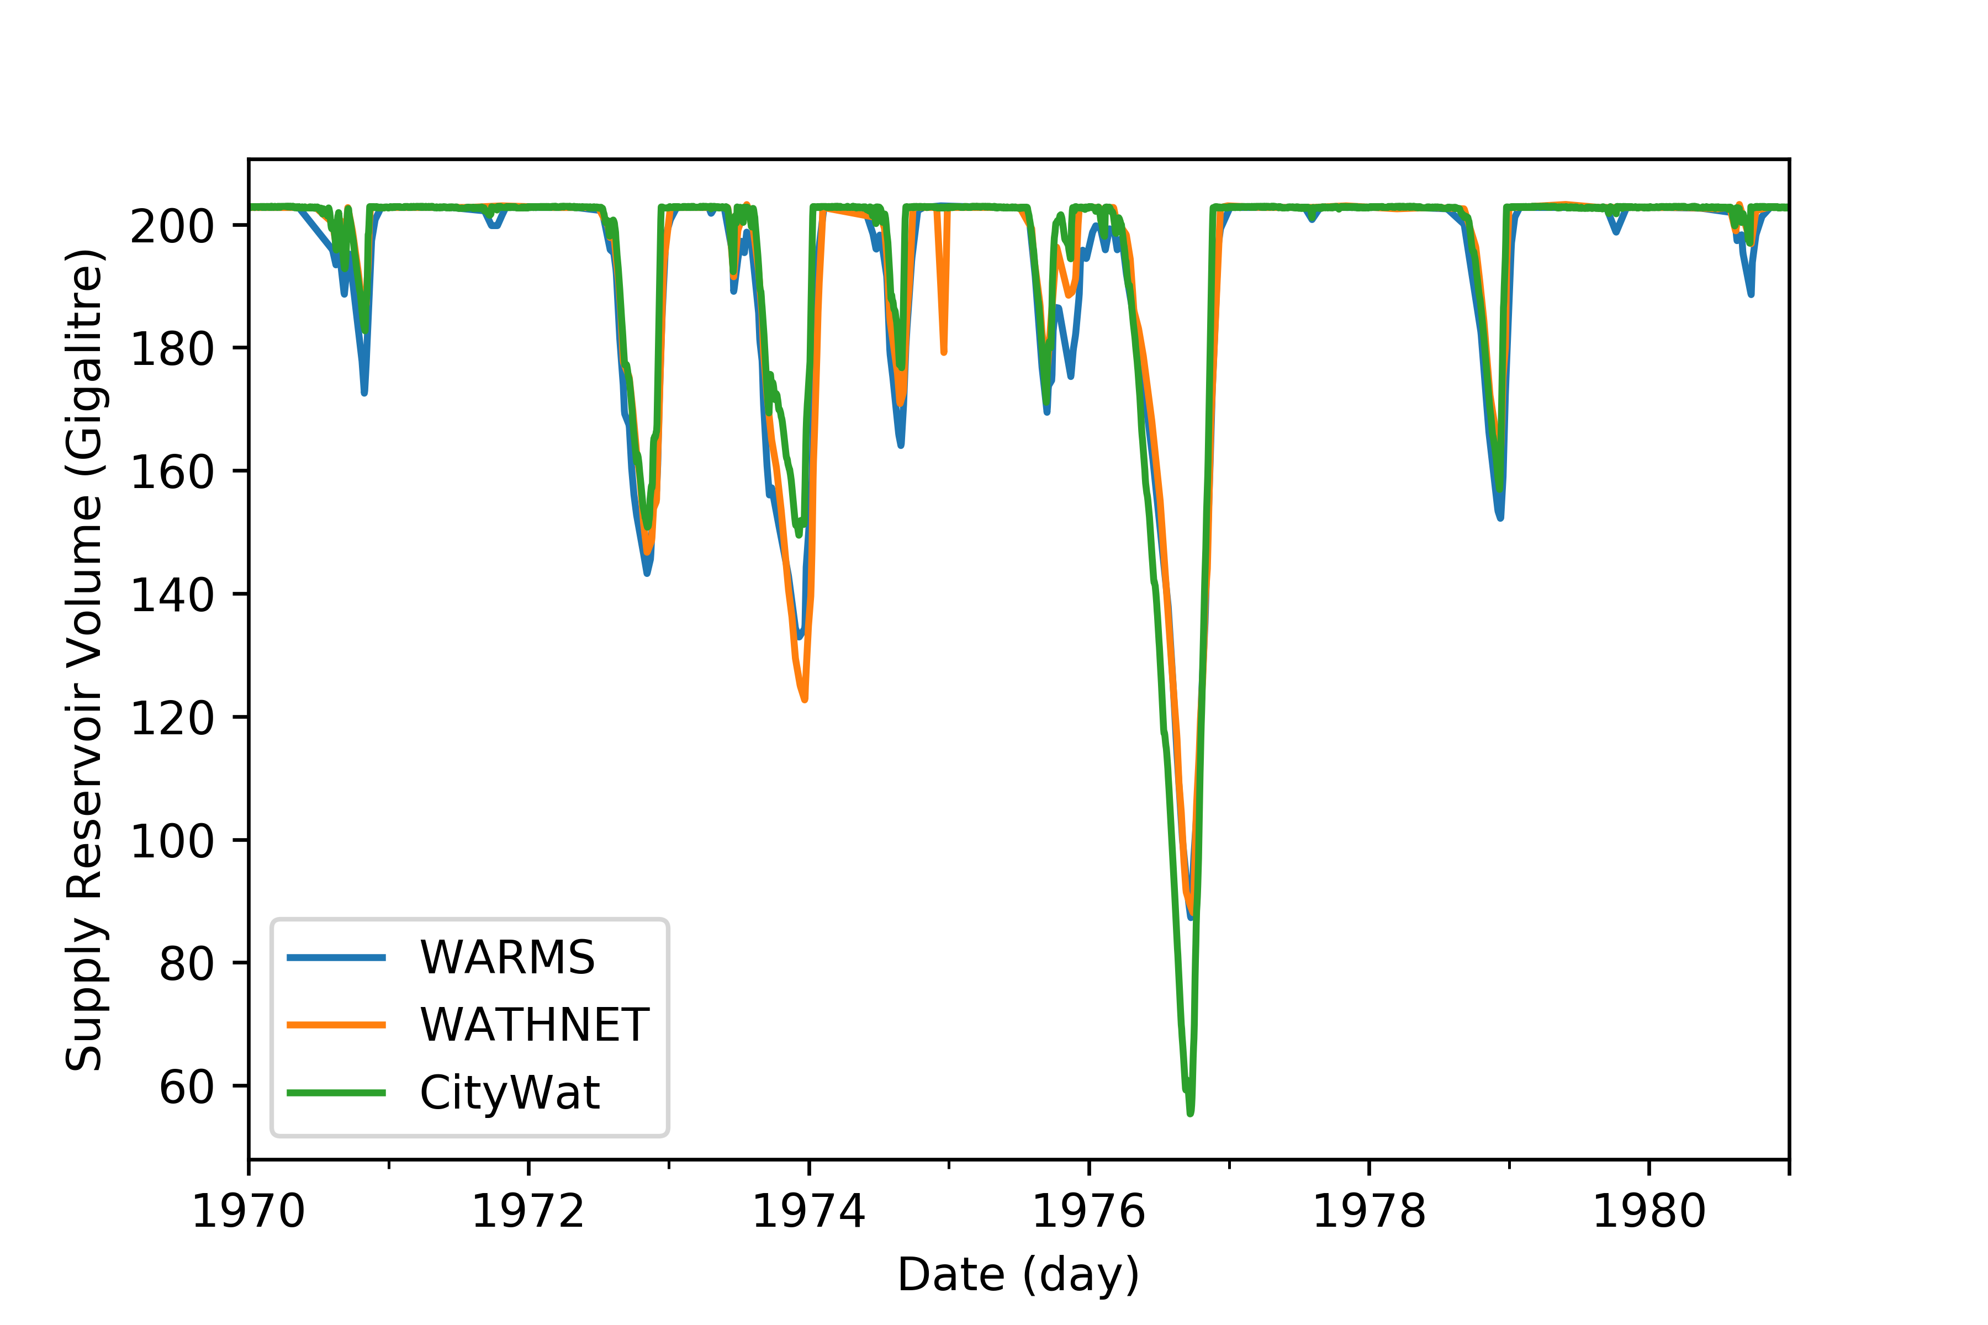
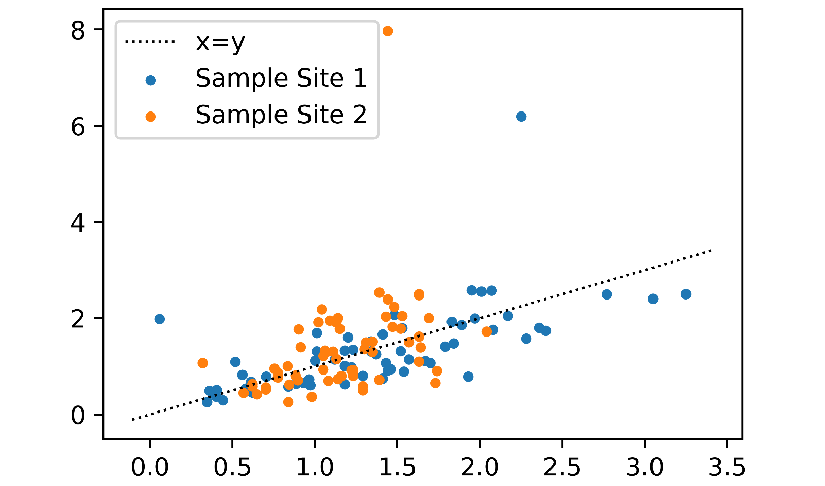
Proof of concept simulations at city scale
CityWat Modelled Phosphorus (mg/l)
Sampled phosphorus (mg/l)
Our lumped model does a reasonable job of projecting supply reservoir volume – we expect differences to occur due to omission of emergency options (e.g. NLARS/Stratford Box) – NSE = 0.85
It also does quite well when compared with downstream River Thames phosphorus samples! The outliers are during spill events, which aren’t included in the samples. When these spill events are removed the correlation coefficient with sample site 1 is 0.75 and 0.51 with sample site 2.

Slide 13
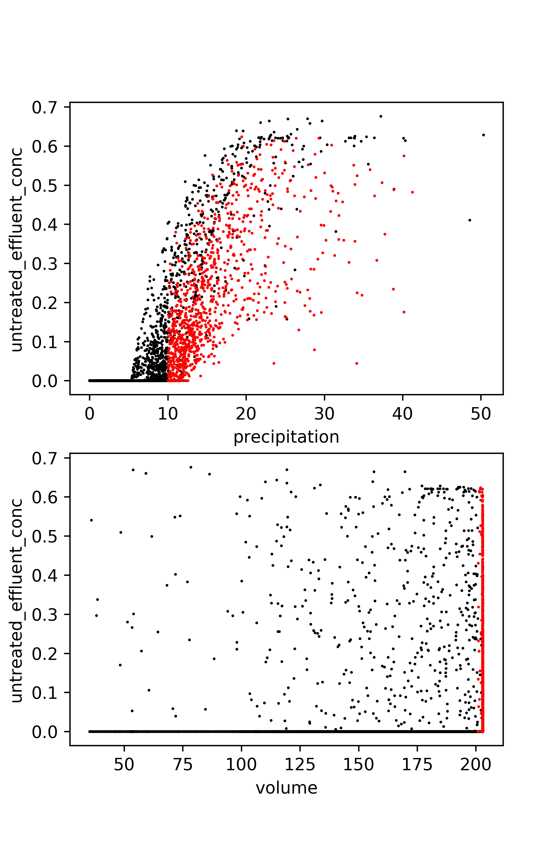
Operational control to manage pollution
Reservoir
Default
Rain
Untreated effluent (Proportion of river flow)
Upstream river
Downstream river
Precipitation (mm/d)
Abstraction
Effluent discharge
~50% untreated effluent concentration
Untreated effluent (Proportion of river flow)
If reservoir > 99% full
Abstraction effluent-dilution (AED)
Minimize abstraction
If precipitation > 10mm
~25% untreated effluent concentration
Supply Reservoir Volume (Gl)

Slide 14
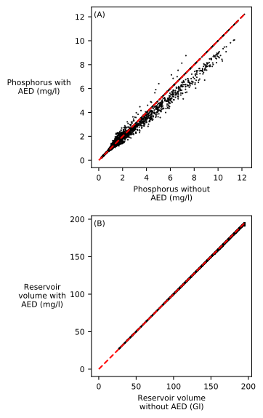
AED benefits
… so what?
The reduction in untreated effluent concentration is equivalent to a new 180Ml stormwater storage tank equivalent to £100 million’s of investment
…
Only additional 6 days of level 1 restrictions over a 120-year period

Slide 15
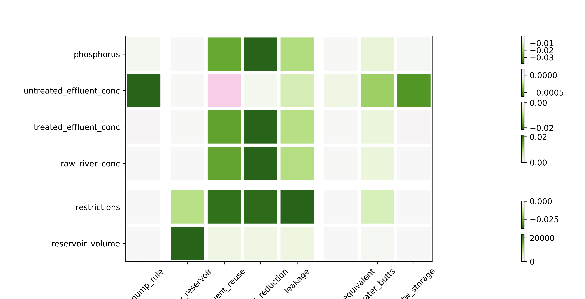

Integarted planning options
Supply metrics
Wastewater metrics
State variable
Water use restriction (probability of a given day)
Untreated effluent (Proportion of river flow)
Not effluent (Proportion of river flow)
Reservoir volume (Gl)
Treated effluent (Proportion of river flow)
Phosphorus (mg/l)
Planning option
Abstraction effluent-dilution
Distribution
Consumption
Sewerage
Options Key
New reservoir
-L
-D
CSO
-R
Reduction in runoff coefficient
Freshwater Treatment
Wastewater Treatment
Land runoff
+S
Increase in storage capacity
Wastewater reuse
+C
Increase in treatment capacity
Supply options
+Q
-D
Decrease in water demand
Demand reductions
Supply System
+S
+C,∆,S
+S
-R
-L
Decrease in distribution leakage
+Q
Increase in effluent quality
Leakage reductions
River
+∆
Increase in treatment rate change
New wastewater reuse/rainwater
harvesting link
Green roofs
Groundwater
Wastewater options
Rainwater harvesting
Stormwater storage
Improvement scale for metrics (greener is better)
e-4

Slide 16
Future plannning and climate change
Slide to be added

Slide 17
Thank you for your
attention!

Slide 18
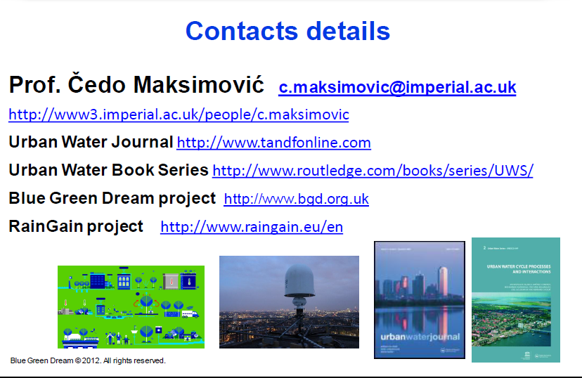
Contact details

Slide 19
Contact details
Dr Ana Mijic ana.mijic@imperial.ac.uk
Co-Director, Centre for Systems Engineering and Innovation https://www.imperial.ac.uk/systems-engineering-innovation
Systems Theme Lead, CAMELLIA programme
https://www.camelliawater.org

